Slide 1
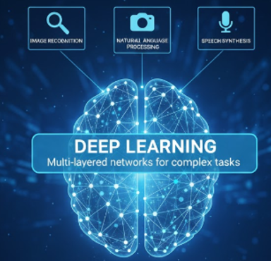
DEEP LEARNING MODULE:1
INTRODUCTION TO NEURAL NETWORKS AND PERCEPTRON

Slide 2
LEARNING OBJECTIVES
Understand neural networks
Explain the biological inspiration behind neural networks
Describe neuron models
Understand neural network architectures
Explain the perceptron model
Understand the Perceptron Convergence Theorem
Relate perceptron's to Bayes classifiers

Slide 3
AI VS ML VS DL
AI | ML | DL
Broad field of creating intelligent systems. | Subset of AI that enables systems to learn from data. | Subset of ML that uses deep neural networks to learn complex patterns.
Mimics human intelligence and decision-making. | Learns from historical data using algorithms. | Learns automatically using multiple layers of artificial neurons.
May use rules, logic, search algorithms, and learning methods. | Uses algorithms such as Linear Regression, Decision Trees, SVM, etc. | Uses Artificial Neural Networks (ANN), CNNs, RNNs, Transformers, etc.
Can work with or without learning from data. | Requires structured data for training. | Performs well with large volumes of structured and unstructured data.
Example: Expert systems, chess-playing programs, virtual assistants. | Example: Email spam detection, house price prediction, customer churn prediction. | Example: ChatGPT, facial recognition, self-driving cars, medical image analysis.
AI is the largest circle – the goal is to make machines intelligent.
ML is a subset of AI – machines learn from data.
DL is a subset of ML – machines learn using deep neural networks.
Artificial Intelligence (AI)
│
├── Machine Learning (ML)
│ │
│ └── Deep Learning (DL)

Slide 4
What is DL?
Deep Learning is a subset of Machine Learning.
Uses Artificial Neural Networks with multiple hidden layers.
Learns complex patterns automatically from data.
Inspired by the structure and functioning of the human brain.
Applications:
Image Recognition
Speech Recognition
Chatbots
Self-driving Cars

Slide 5
What is Neural Network?
A Neural Network is a computational model inspired by the human brain.
Definition:
A neural network consists of interconnected processing units called neurons that work together to solve problems.
Characteristics:
Learning capability
Pattern recognition
Generalization
Adaptability

Slide 6
HUMAN BRAIN as INSPIRATION
Human Brain Facts:
Approximately 86 billion neurons
Neurons communicate through electrical signals
Learning occurs by strengthening connections
Components:
Dendrites → Receive signals
Cell Body → Processes information
Axon → Sends signals
Synapse → Connection between neurons

Slide 7
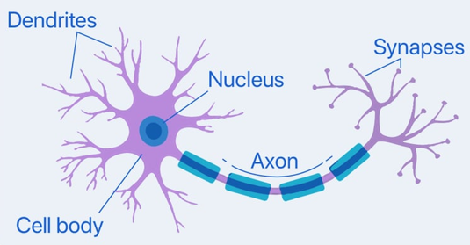
BIOLOGICAL NEURON
Dendrites
Cell Body
Axon
Synapse
Signal flow from dendrites to axon.
Electrochemical conduction happens in brain : K⁺ , Na⁺ jumps from one neuron to another to pass signals, impulsive signals

Slide 8
BENEFITS OF nn
Nonlinearity
Input-output Mapping
Adaptivity
Evidential Response
Contextual Information
Fault Tolerance
VLSI Implementability
Uniformity of Analysis & Design
Neurobiological Analogy

Slide 9
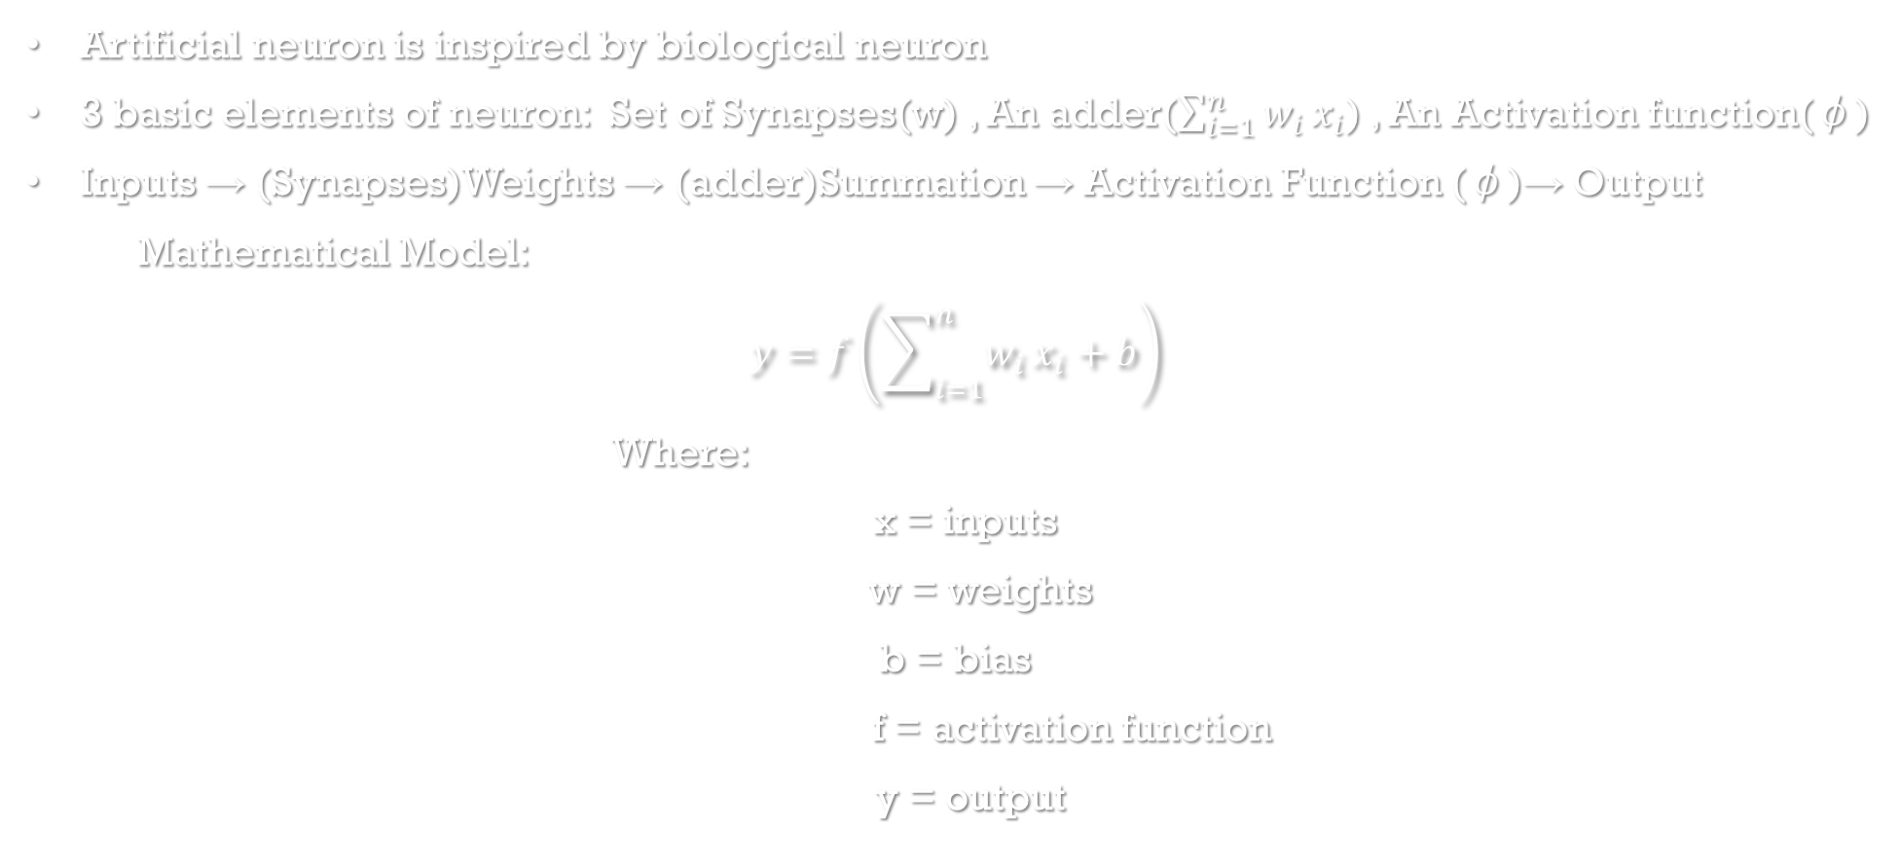
ARTIFICIAL NEURON MODEL
Artificial neuron is inspired by biological neuron
3 basic elements of neuron: Set of Synapses(w) , An adder($\sum_{i=1}^{n}{w_{i}}x_{i}$) , An Activation function(φ)
Inputs → (Synapses)Weights → (adder)Summation → Activation Function (φ)→ Output
Mathematical Model:
$$y=f\left(\sum_{i=1}^{n}{w_{i}}x_{i}+b\right)$$
Where:
x = inputs
w = weights
b = bias
f = activation function
y = output

Slide 10
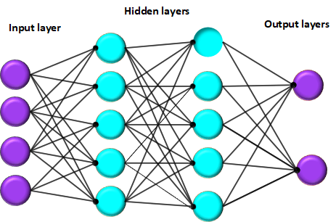

Slide 11
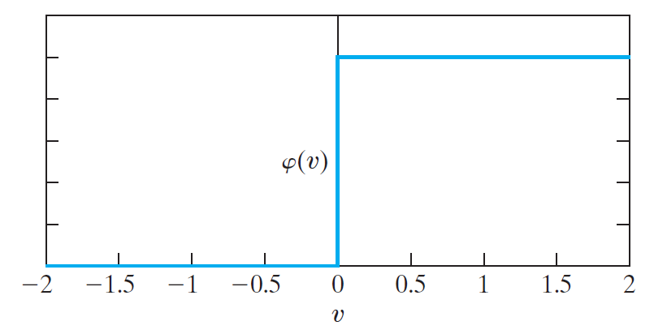
types of activation model
Threshold Function:
φ(v) defines output of a neuron in terms of the induced local field v.
φ(v) = 1 if v ≥ 0
0 if v < 0
Output is either 0 or 1
Used in the Perceptron.

Slide 12
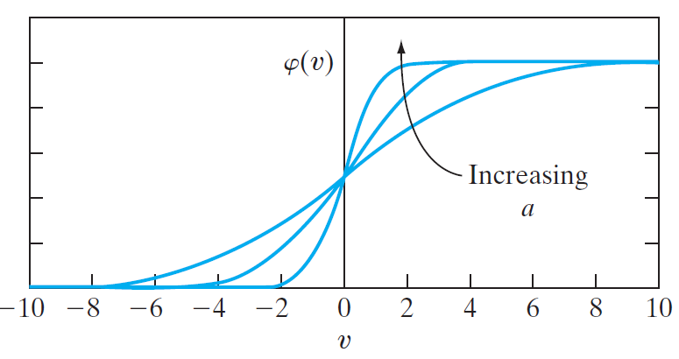
2. Sigmoid Function:
Graph is S-shaped, sigmoid is logistic function
Output ranges from 0 to 1
Suitable for binary classification.
3. Tanh Function:
Sigmoid function can also be defined as hyperbolic tangent function
φ(v) = tanh(v)
φ(v) = 1 /1 + exp(-bv)
φ(v) = 1 if v ≥ 0
0 if v = 0
-1 if v < 0
Output ranges from -1 to 1.
Zero-centered.
4. ReLU Function:
Outputs 0 for negative values
Input itself for positive values
Most widely used in deep learning because it is simple and computationally efficient.

Slide 13
Why activation function needed?
Decides whether a neuron should be activated.
Introduces non-linearity into the network.
Enables learning of complex patterns.
Controls the output passed to the next layer.
Helps solve problems like image recognition, speech recognition, and natural language processing.
The activation function determines how the neuron responds to the input.
Inputs → Features
Weighted Sum → Net Input
Activation Function → Decision
Output → Final Prediction
Without Activation Function | With Activation Function
Only linear relationships | Learns linear and non-linear relationships
Deep network behaves like one linear layer | Deep network becomes powerful
Cannot solve complex problems | Can solve complex real-world problems

Slide 14
"If a deep neural network has 100 hidden layers but no activation function, will it be more powerful than a single-layer linear model?"

Slide 15


Neural Networks as Directed Graphs
A neural network can be represented as a directed graph.
Nodes represent neurons.
Edges represent weighted connections.
Information flows through directed links.
2- different types of links:
(i) Synaptic links : Input and output relation is linear
(ii)Activation links : Input and output relation is non-linear

Slide 16
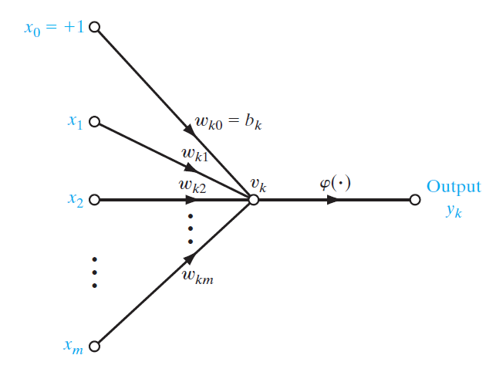
A neural network is a directed graph consisting of nodes with interconnecting synaptic and
activation links and is characterized by four properties:
1. Each neuron is represented by a set of linear synaptic links, an externally applied bias, and a possibly nonlinear activation link. The bias is represented by a synaptic link connected to an input fixed at 1.
2. The synaptic links of a neuron weight their respective input signals.
3. The weighted sum of the input signals defines the induced local field of the neuron in question.
4. The activation link squashes the induced local field of the neuron to produce an output.

Slide 17
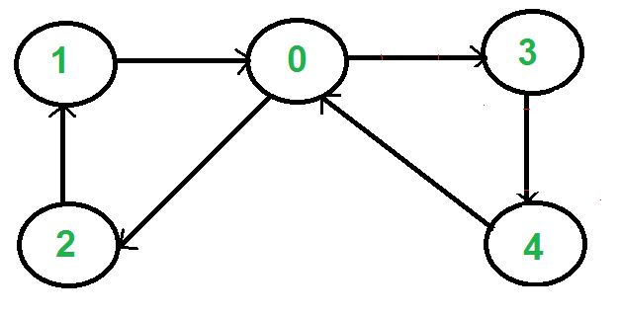
Directed Graph Example
Input Layer → Hidden Layer → Output Layer
Vertices = neurons
Edges = weights

Slide 18
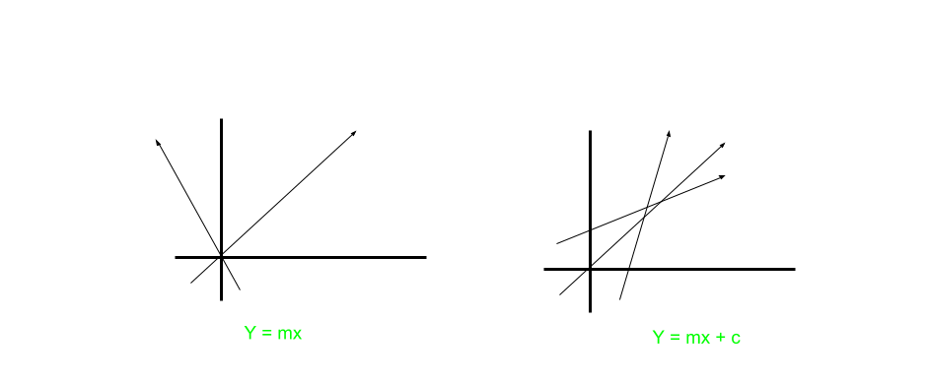
WHY BIAS IS required?
Bias allows a neuron to shift its activation function, enabling it to learn patterns that do not pass through the origin (0,0).
Without bias, a neuron has limited flexibility and cannot represent many real-world decision boundaries.
To give the model the flexibility to shift and fit data patterns more accurately.

Slide 19
Feedback in Neural Networks
Two types:
Feedforward Networks
No loops
Signal moves in one direction
Feedback Networks
Contains loops
Output influences future inputs

Slide 20
Feedforward Network
Characteristics:
Simpler architecture
Easy training
Used in classification
Examples:
Perceptron
Multilayer Perceptron

Slide 21
Feedback Network
Characteristics:
Dynamic behaviour
Memory capability
Time-dependent processing
Examples:
Hopfield Network
Recurrent Neural Network (RNN)

Slide 22
Network Architectures
Single Layer Network
Input → Output
Multi-Layer Network
Input → Hidden Layer(s) → Output

Slide 23
Types of Network Architecture
Single Layer Feedforward
Multi Layer Feedforward
Recurrent Networks

Slide 24
Perceptron
A perceptron is a supervised learning algorithm that classifies input data into one of two classes.
The Perceptron is the first artificial neural network model developed for binary classification.
It was introduced by Frank Rosenblatt in 1958.
It is inspired by the working of a biological neuron and is considered the foundation of modern neural networks.

Slide 25
Rosenblatt's Perceptron
Earlier computers followed fixed instructions.
Can a machine learn from experience instead of being explicitly programmed?
Rosenblatt introduced the Perceptron, which could:
Learn from training data.
Adjust its weights automatically.
Perform binary classification.

Slide 26
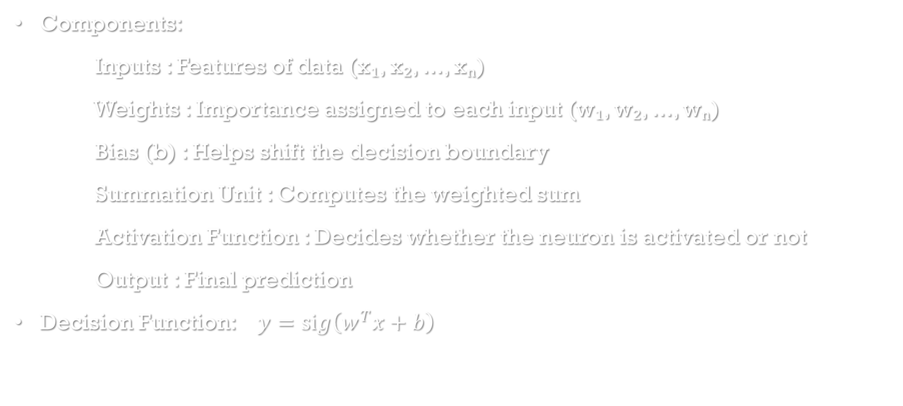
Structure of Perceptron
Components:
Inputs : Features of data (x₁, x₂, ..., xₙ)
Weights : Importance assigned to each input (w₁, w₂, ..., wₙ)
Bias (b) : Helps shift the decision boundary
Summation Unit : Computes the weighted sum
Activation Function : Decides whether the neuron is activated or not
Output : Final prediction
Decision Function: $y=sig\left(w^{T}x+b\right)$

Slide 27
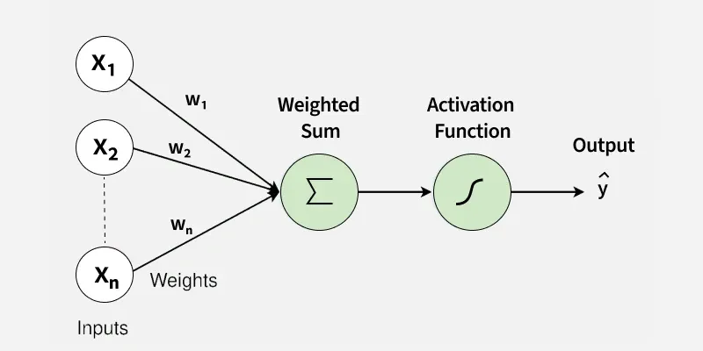

Slide 28
Perceptron Algorithm
Step 1: Receive input values.
Step 2: Multiply each input by its corresponding weight.
Step 3: Add all weighted inputs.
Step 4:Add the bias.
Step 5: Apply the activation function.
Step 6:Generate the final output

Slide 29
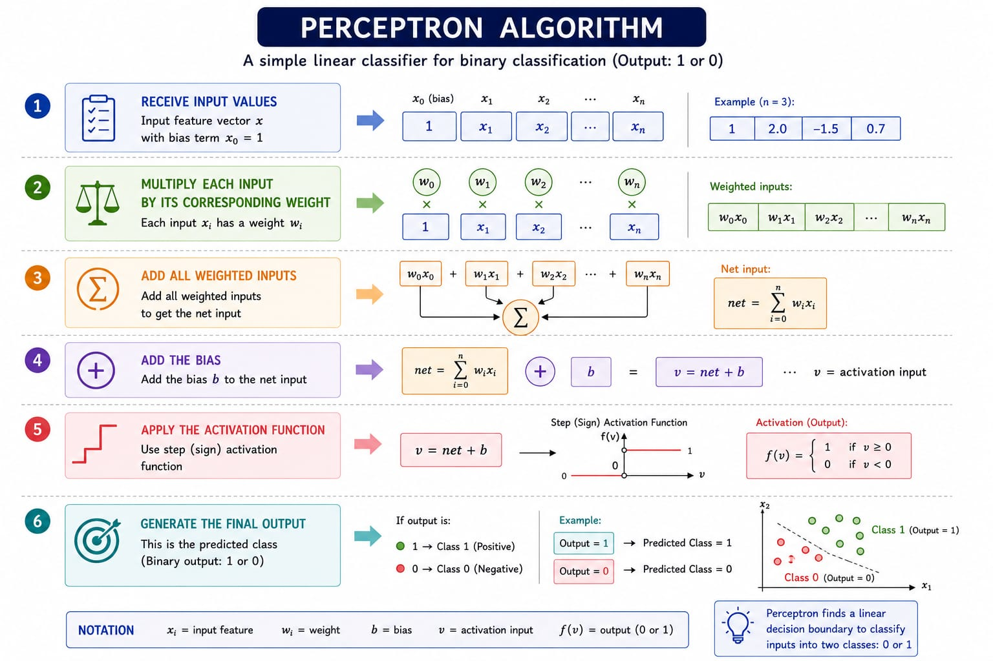

Slide 30
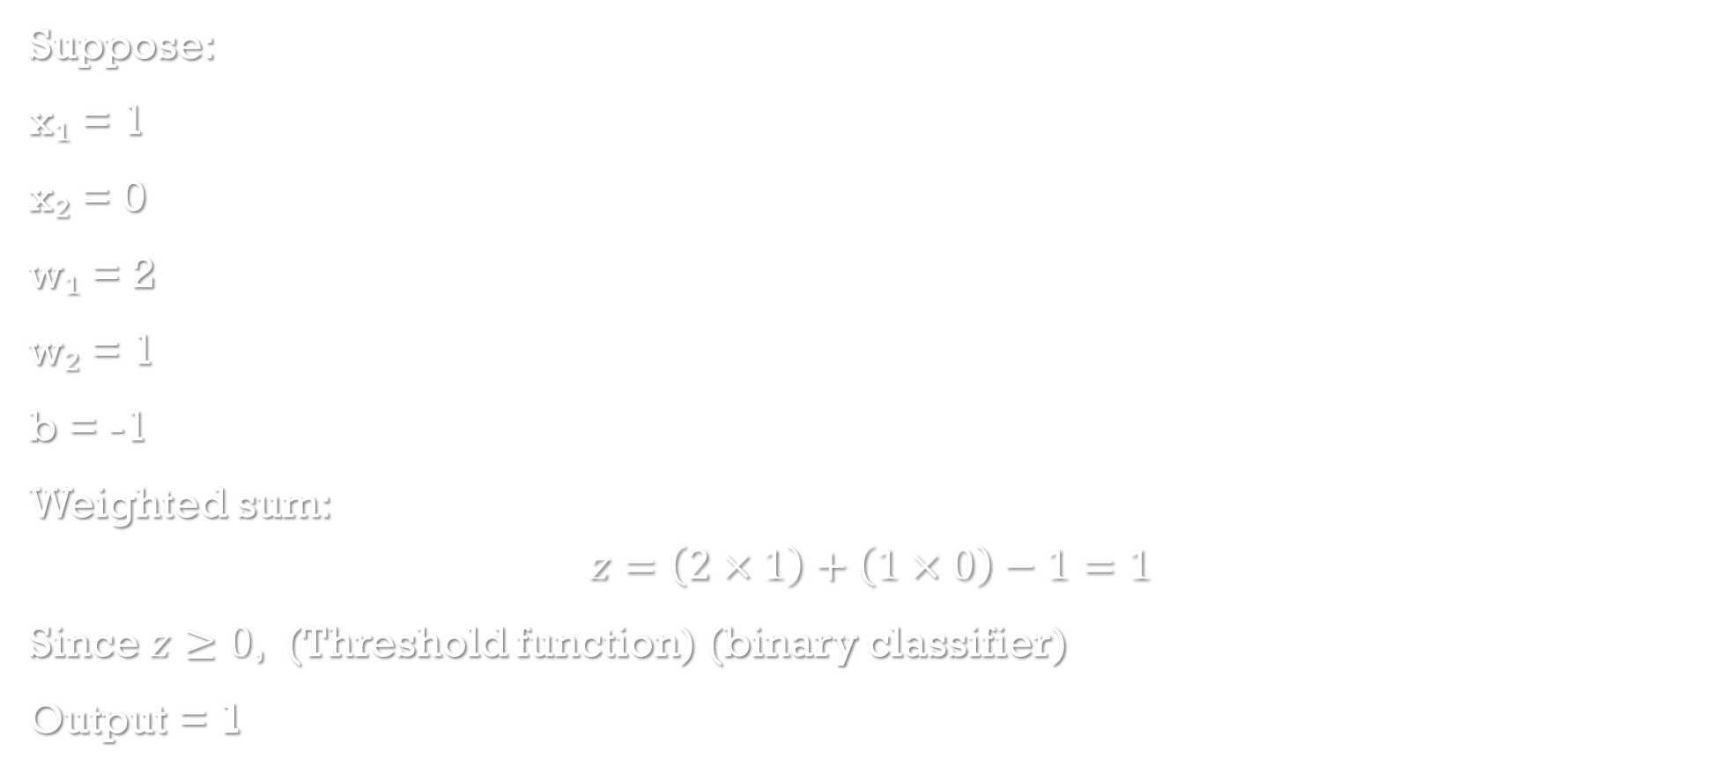
Example
Suppose:
x₁ = 1
x₂ = 0
w₁ = 2
w₂ = 1
b = -1
Weighted sum:
$$z=\left(2×1\right)+\left(1×0\right)−1=1$$
Since $z≥0$, (Threshold function) (binary classifier)
Output = 1

Slide 31


NUMERICALS ON PERCEPTRON
SOLVE THE FOLLOWING PROBLEMS
Classroom Activity: find the output of the perceptron. (AND GATE USING PERCEPTRON)
Q:1
$$x_{1}$$ | $$x_{2}$$ | $$w_{1}$$ | $$w_{2}$$ | Bias | Net Input | Output
1 | 1 | 0.5 | 0.5 | -0.7 | ? | ?
1 | 0 | 0.5 | 0.5 | -0.7 | ? | ?
0 | 1 | 0.5 | 0.5 | -0.7 | ? | ?
0 | 0 | 0.5 | 0.5 | -0.7 | ? | ?
Q2:
A perceptron has the following parameters:
Inputs: $x_{1}=1, x_{2}=1, x_{3}=0$
Weights: $w_{1}=0.4, w_{2}=0.3, w_{3}=0.5$
Bias: $b=−0.6$
Using the threshold activation function
$$f\left(z\right)=\left\{\begin{matrix}1, & z≥0 \\ 0, & z<0\end{matrix}\right.$$
find the output of the perceptron.

Slide 32

find the output of the perceptron.
Q3
Given
Parameter | Value
$$x_{1}$$ | 1
$$x_{2}$$ | 0
$$x_{3}$$ | 1
$$w_{1}$$ | 0.3
$$w_{2}$$ | 0.4
$$w_{3}$$ | 0.5
$$b$$ | -0.4

Slide 33

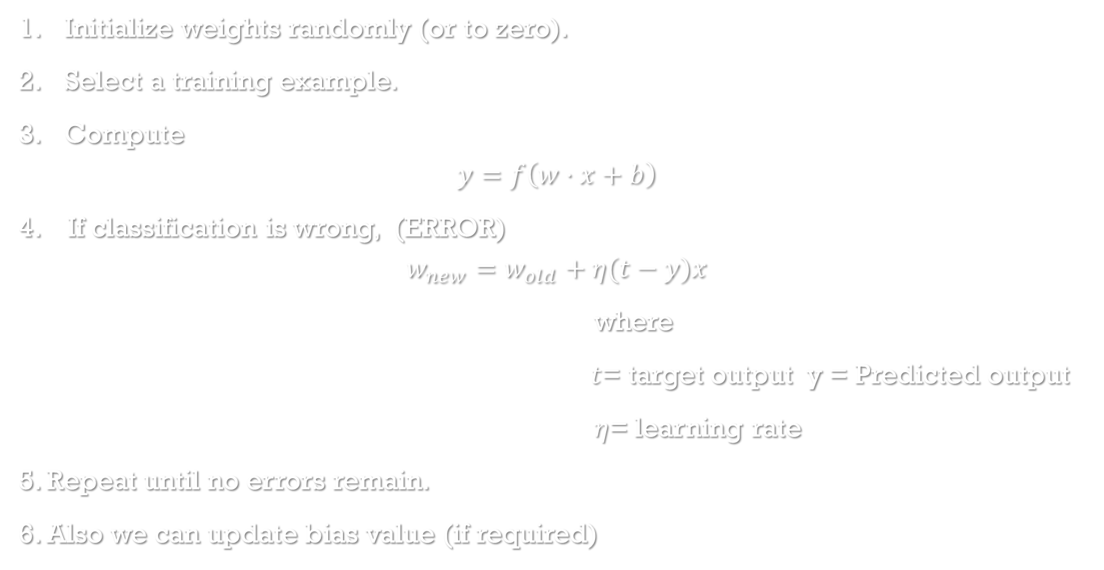
PERCEPTRON LEARNING ALGORITHM
Initialize weights randomly (or to zero).
Select a training example.
Compute
$$y=f\left(w⋅x+b\right)$$
4. If classification is wrong, (ERROR)
$$w_{new}=w_{old}+η(t−y)x$$
where
$t$= target output y = Predicted output
$η$= learning rate
5. Repeat until no errors remain.
6. Also we can update bias value (if required)

Slide 34
What is Learning Rate in a Perceptron/Neural Network
The learning rate (denoted by η (eta) or α (alpha)) is a hyperparameter that determines how much the weights are adjusted during each learning step.
Definition:
Learning rate is the step size used to update the weights of a neural network during training.

Slide 35
WHY LEARNING RATE REQUIRED?
The learning rate controls how fast or slow the model learns.
Small learning rate (η = 0.01):
  Small weight updates
  Slow learning
  More stable
  May require many iterations
Large learning rate (η = 1 or more):
  Large weight updates
  Faster learning
  May overshoot the optimal solution
  Can make training unstable

Slide 36
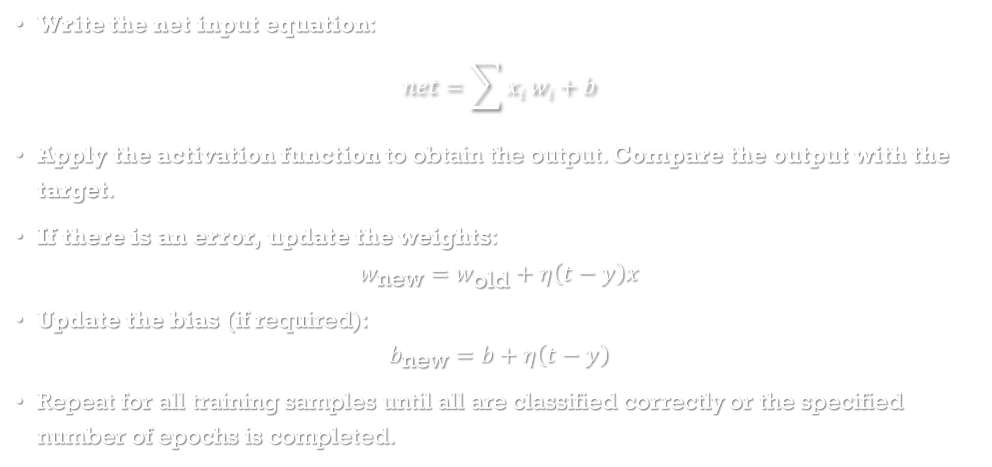
HOW TO SOLVE ANY PERCEPTRON PROBLEM
Write the net input equation:
$$net=\sum{x_{i}}w_{i}+b$$
Apply the activation function to obtain the output. Compare the output with the target.
If there is an error, update the weights:
$$w_{\text{new}}=w_{\text{old}}+η\left(t−y\right)x$$
Update the bias (if required):
$$b_{\text{new}}=b+η\left(t−y\right)$$
Repeat for all training samples until all are classified correctly or the specified number of epochs is completed.

Slide 37
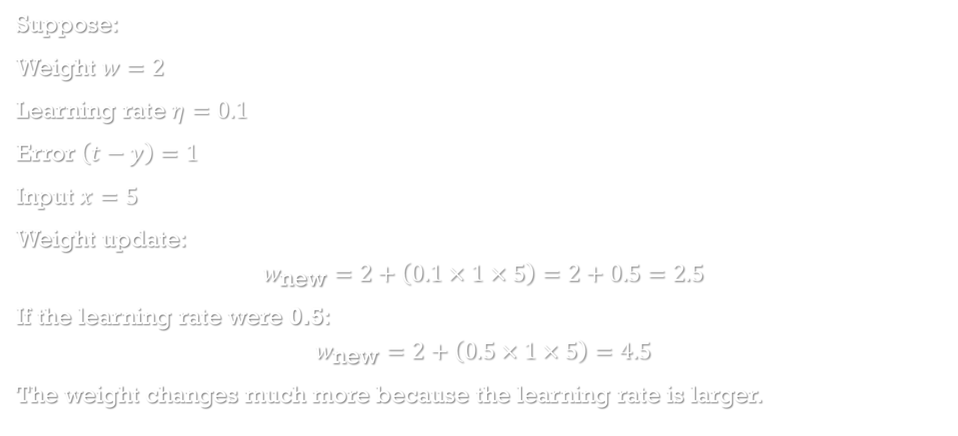
EXAMPLE
Suppose:
Weight $w=2$
Learning rate $η=0.1$
Error $\left(t−y\right)=1$
Input $x=5$
Weight update:
$$w_{\text{new}}=2+\left(0.1×1×5\right)=2+0.5=2.5$$
If the learning rate were 0.5:
$$w_{\text{new}}=2+\left(0.5×1×5\right)=4.5$$
The weight changes much more because the learning rate is larger.

Slide 38


PROBLEMS TO SOLVE:
Q4
Initial weights
$$w=\left[0 , 0\right]$$
Learning rate
$$η=1$$
Training data
CHECK IF THE TARGET VALUE OBTAINED IS CORRECT, IF NOT UPDATE WITH NEW WEIGHTS
x1 | x2 | Target
1 | 1 | 1
-1 | -1 | -1
Q5 REPRESENT OR GATE WITH PERCEPTRON ALGORITHM FOR THE GIVEN
Weights: $\left[1 , 1\right]$Bias: $−0.5$
Q6 TRAIN A PERCEPTRON FOR GIVEN
Initial $w=\left[0 , 0\right]$Learning rate: $1$Training sample $x=\left[2 , 3\right]$Target:$1$

Slide 39
AT ONE POINT PERCEPTRON STOPS. WHY?
Every time the perceptron makes a mistake:
the weight vector moves closer to the correct separating hyperplane
after a finite number of corrections, no mistakes remain.
The proof shows:
the weight vector's projection toward the optimal solution keeps increasing,
while its length cannot grow too quickly,
therefore only a finite number of mistakes are possible.

Slide 40
A perceptron is itself a Machine Learning (ML) algorithm.
We use the perceptron specifically because it was the first neural network model designed to mimic the way a biological neuron makes decisions.
While many ML algorithms can perform classification, the perceptron introduces the fundamental concepts on which modern neural networks and deep learning are built.
Why not use any ML algorithm?
Different ML algorithms are designed for different purposes.
ML Algorithm | Use Case | Why not always use it?
Perceptron | Linearly separable binary classification | Simple and forms the foundation of neural networks
Decision Tree | Linear and non-linear classification | More complex; doesn't explain neuron learning
SVM | Linear and non-linear classification | Computationally more expensive
KNN | Classification based on nearest neighbors | No learning of weights
Naïve Bayes | Probabilistic classification | Assumes feature independence

Slide 41
Perceptron Convergence Theorem
Statement:
If training data are linearly separable, the perceptron learning algorithm converges to a solution in a finite number of steps.
Significance:
Guaranteed learning
Theoretical foundation of neural networks
Limitation:
Fails for non-linearly separable problems
Motivation:
This limitation motivated the development of multi-layer neural networks with nonlinear activation functions.

Slide 42
Example – XOR Problem
Truth Table:
X1 | X2 | OUTPUT
0 | 0 | 0
0 | 1 | 1
1 | 0 | 1
1 | 1 | 0
XOR outputs 1 when the inputs are different.
XOR is not linearly separable.
A single-layer perceptron fails because it can only learn a linear decision boundary.
A multi-layer neural network with activation functions can learn a non-linear decision boundary and correctly classify XOR.
This is one of the most important examples in Deep Learning because it clearly shows why hidden layers and activation functions are essential.

Slide 43
Advantages & Limitations of PLA
ADVANTAGES
Simple architecture
Easy to implement
Fast Learning
Good for binary classification
Foundation for DL
LIMATIONS
Solves Linearly separable problems
Cannot solve XOR problem
Uses only one layer
Limited learning capability

Slide 44
REAL-LIFE EXAMPLE
CLASSIFY EMAIL IS SPAM / NOT SPAM
Which one is making more informed decision
CLASSIFIER 1 | CLASSIFIER 2
Uses one i/p Feature | consider probability of belonging to each class
Learns by updating weights | Sample is assigned to Higher probability class

Slide 45
BAYES CLASSIFIER
Definition:
A Bayes Classifier is a statistical classification algorithm that assigns an input sample to the class with the highest posterior probability. (Posterior = useful evidence / total evidence)
Decision Rule:
P(A∣B)=P(B∣A) P(A)​ / P(B)
P(A|B) = Posterior Probability
P(B|A) = Likelihood
P(A) = Prior Probability
P(B) = Evidence
Advantages:
Optimal classification
Minimum probability of error

Slide 46

If
Classes follow Gaussian distribution
Equal covariance matrices
Equal variance
Then
Bayesian classifier produces
$$g\left(x\right)=wx+b$$
Perceptron also classifies using
$$Net=wx+b$$
Hence,
Both generate the same linear decision boundary.

Slide 47
Perceptron vs Bayes Classifier in Gaussian Environment
When classes follow Gaussian (Normal) distributions:
Bayes Classifier: Classifies using probability.
Perceptron: Classifies using a learned decision boundary.
In a Gaussian environment with linearly separable classes, both can produce similar linear decision boundaries, but the Bayes classifier represents the optimal probabilistic decision rule under its assumptions.
Similarities:
Both perform classification
Produce decision boundaries
Differences:
PERCEPTRON | BAYES
Learns from data | Uses Probability
Iterative training | Statistical model
Liner separator | Optimal classifier

Slide 48
When two classes are Gaussian distributed with equal covariance, the Bayesian classifier gives a linear decision boundary.
The perceptron also learns a linear decision boundary.
Hence, both classifiers can produce similar classification boundaries under these conditions.

Slide 49
Summary
Neural Networks mimic the human brain.
Artificial neurons are basic building blocks.
Networks can be represented as directed graphs.
Feedforward and feedback architectures exist.
Rosenblatt introduced the Perceptron.
Perceptron converges for linearly separable data.
Bayes classifier provides optimal classification.

